Slide 1
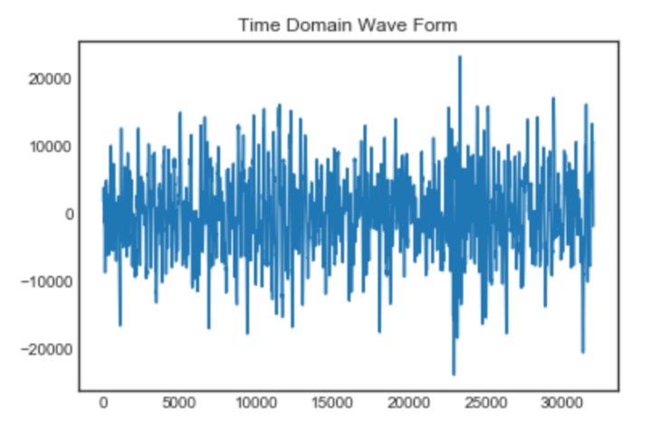
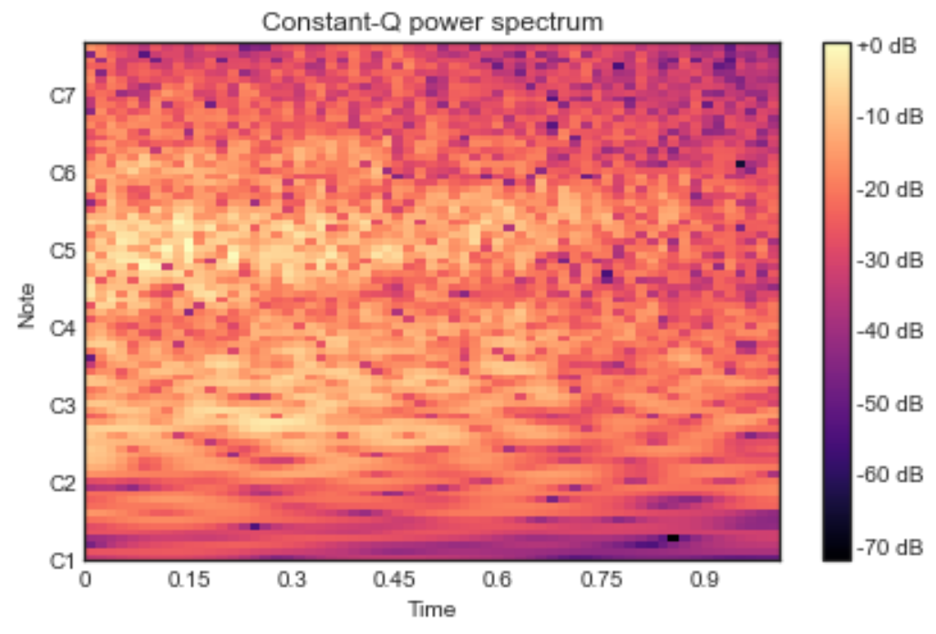
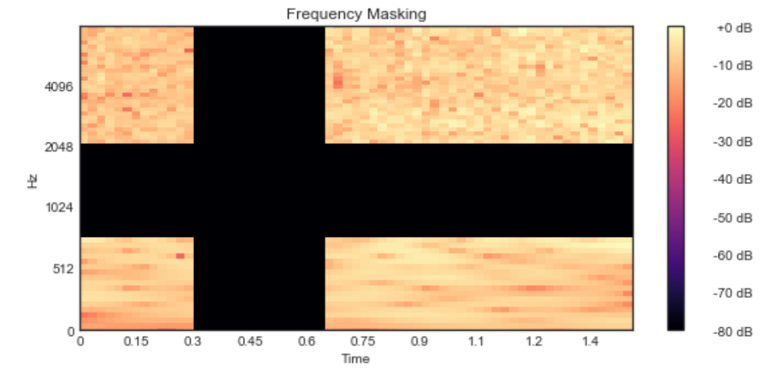
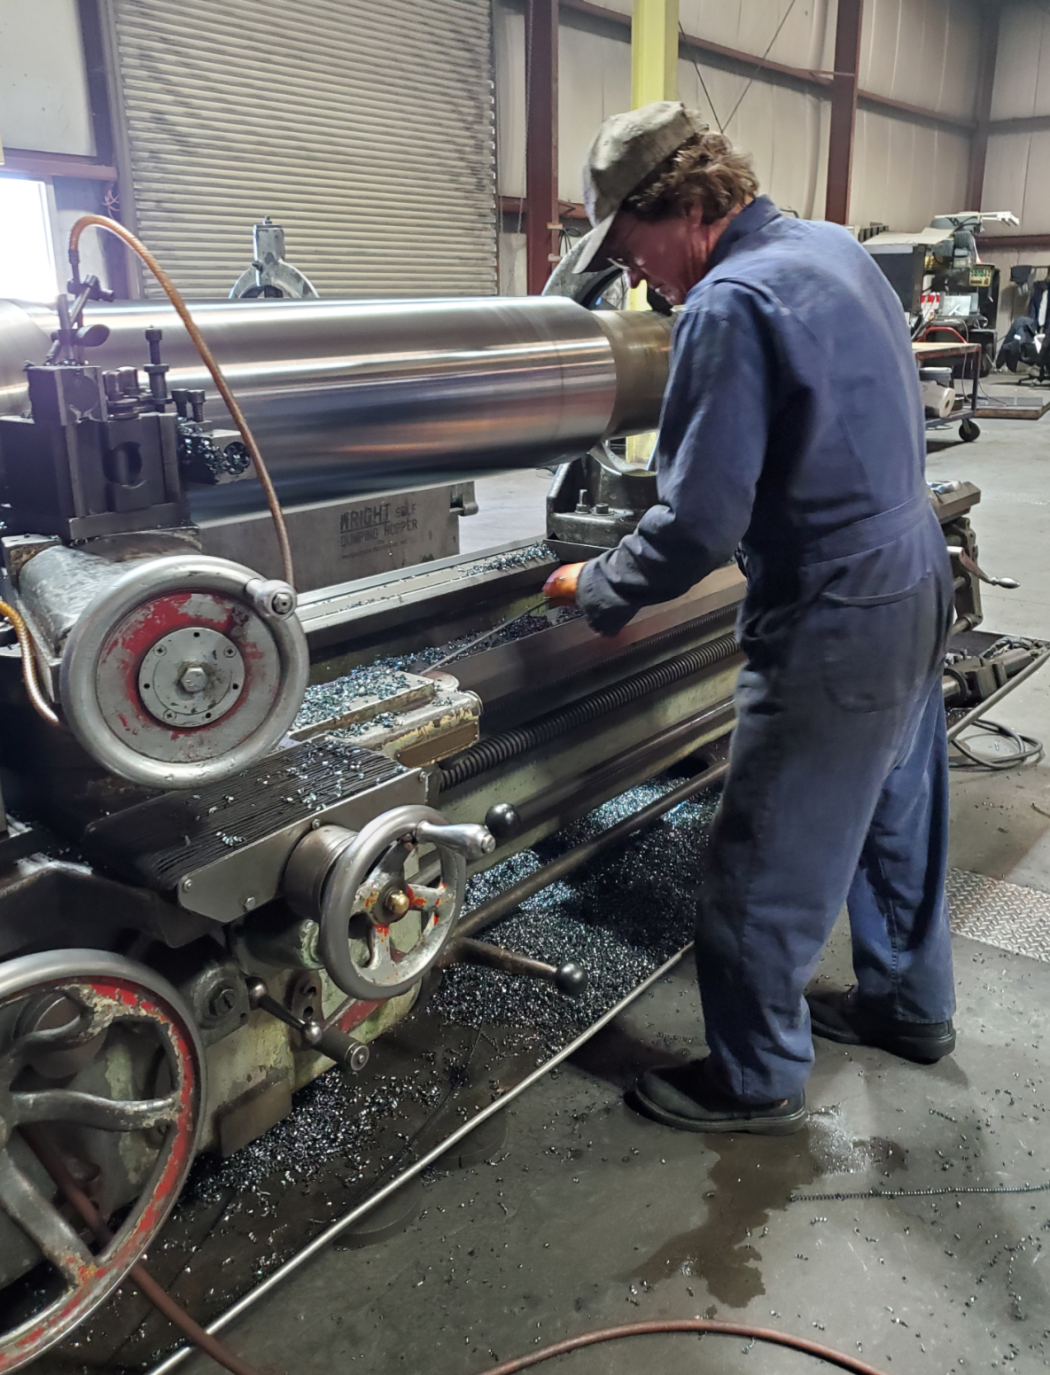
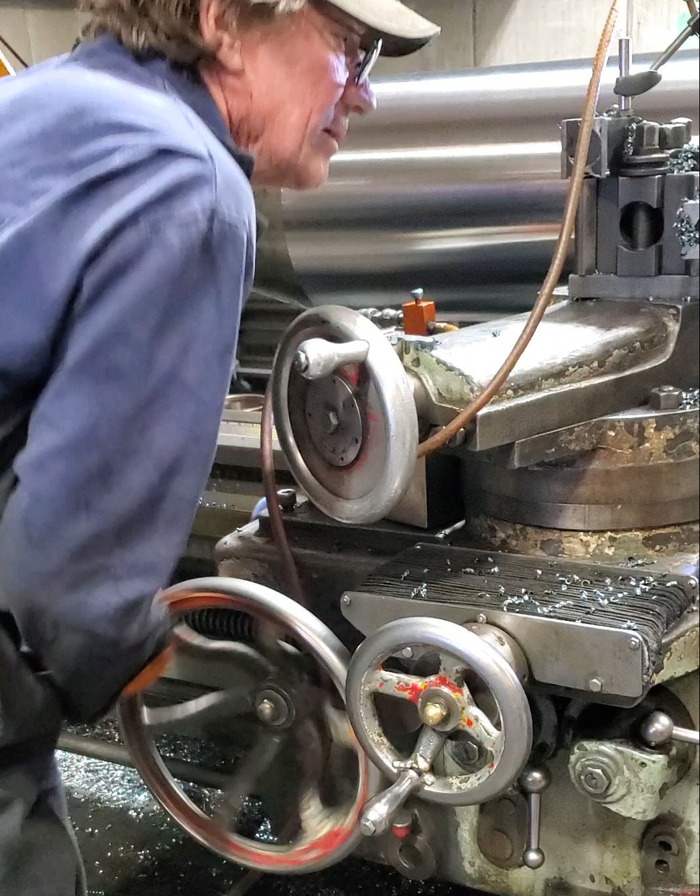
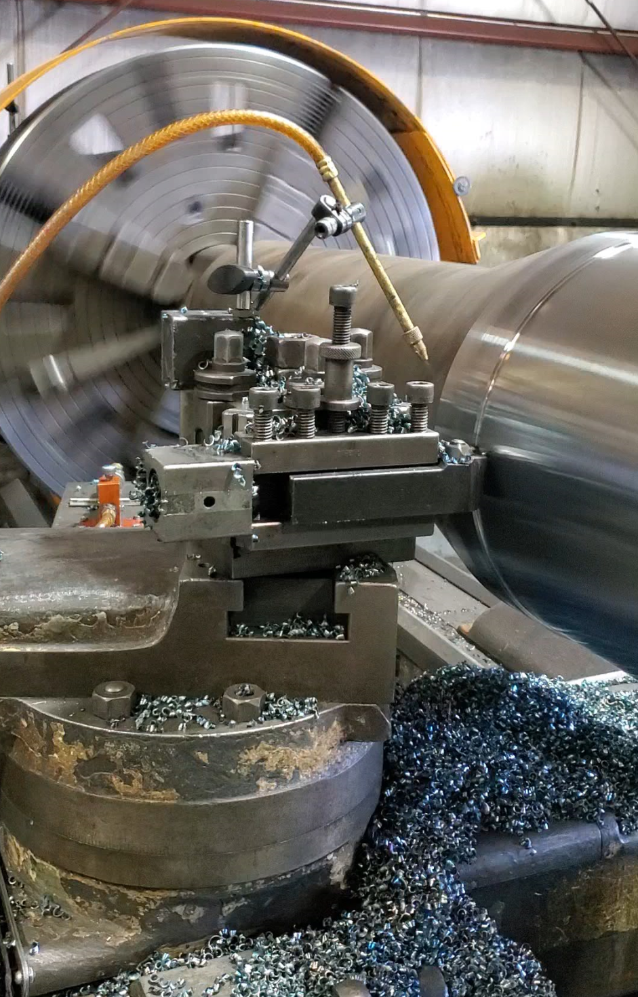

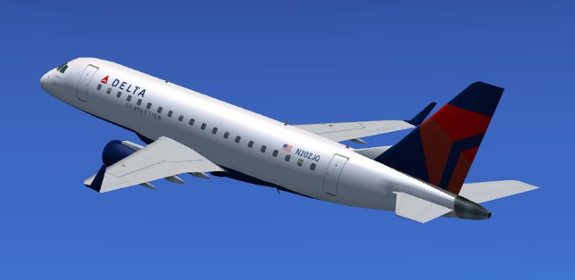
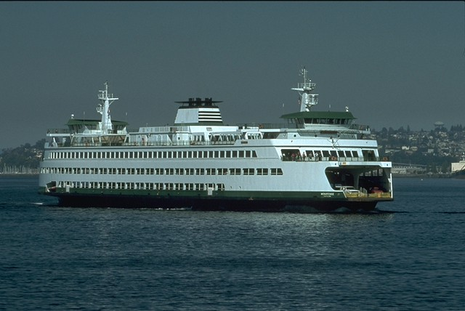
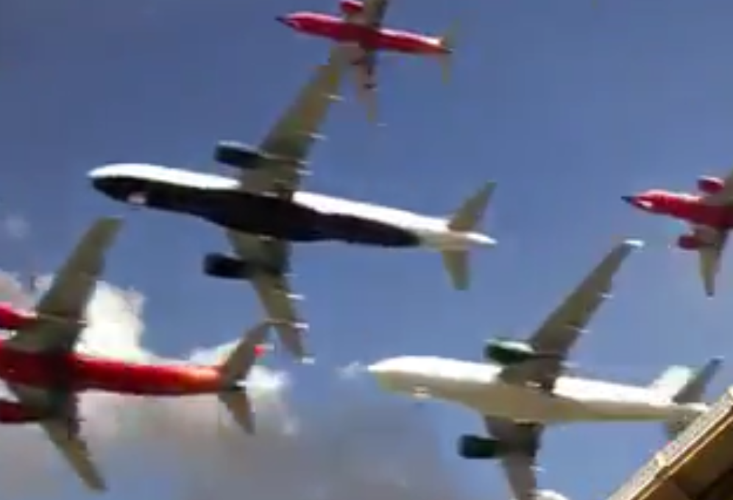

Patty Ryan, Chenhao Yang, Nile Wilson
Commercial Software Engineering
Applied Machine Learning Group
Industrial Audio Classification with Music Domain Features
Listening to Machine Audio to Characterize Quality or Distinguish between Machines
Motivation
How do we scale scarce human experts who can diagnose machine quality by ear?
In a manufacturing setting, sounds that are heard on the factory floor provide unmistakable information about whether a machine or
tool is working correctly or not. Domain experts working in manufacturing environments rely on their sense of hearing, and their
knowledge of what sounds right or wrong to help them identify quality problems based on the sound pitch, rhythm, timbre and other characteristics. Using machine learning to classify these sounds has broad applications to automate the manual quality recognition work currently being done. In application, we found we could use the same techniques to distinguish between models of motors or between specific motors.
Characterize ‘Music’ in Machine Audio
Multi-input Model Architecture
Recording and Preprocessing
We demonstrate an applied method for classifying industrial audio using approaches developed in the music domain
We use the Keras functional API with multi-input convnet model combining 1D representations of pitch estimations using pretrained model ‘CREPE’ using time domain waveform, and CQT or STFT 2D transforms
We have applied this method to distinguishes motorized tool quality classes in industrial settings to classify welding quality and machining settings.
The approach also works to classify a variety of motorized sounds that we’ve gathered and tested thus far
We have also applied this method to distinguish between motor sounds as varied as models of aircrafts landing at LAX and specific ferry boats in operation on Puget Sound.
Scarce labeled data of expert quality, and variation between human experts, led us to explore alternative data augmentation techniques
Industrial audio captured @>32000 Hz
Resample to 32000 Hz
Split source recordings to sample groups
Chunk into 1 Second intervals
Featurization of Pitch and Timbre
We characterize pitch and timbre through frequency domain changes over time, represented by 2D spectrograms based on either the Constant Q Transform (CQT) or the Short-Time Fourier Transform (STFT)
CQT is a time-frequency analysis method with higher frequency resolution at lower frequencies and higher time resolution towards higher frequencies3 better capturing both pitch and timbre*
STFT determines the sinusoidal frequency and phase content of local sections of the signal
CREPE transfer learns fundamental frequency using a pre-trained pitch model
1 Second Wave Form
Constant Q Transform
Pitch Estimations
from CREPE Pretrained Model
1DCNN
CQT or STFT
Spectrogram
2DCNN
Masked
Spectrogram
2DCNN
Augmentation
Concatenated
Time and frequency masking of CQT
Added white noise and volume reduction
Masking stabilized learning and increased generalizability
Explored generating synthesized sample, revealed unstable pitch
Classification Output
Masked Time and Frequency
Results
‘VROOM’ Industrial Audio Dataset
‘VROOM’: Various Recordings of Other Motors
Complement to the Urban Sound Dataset ₍₈₎
Notes:
The machining sample includes homogenous machines with the same operator
Other machine tool classifications we’ve measured have had less strong pitch component
LAX landings with wind <15mpg
Models with STFT and CQT included masked time and frequency data augmentation
Dataset to date includes:
Machine tooling at correct and incorrect settings
Commercial ferry boats on Puget Sound
Commercial aircraft landings at LAX and SEA
Boat yard metal grinding operations at Lake Union
https://github.com/SingingData/Vroom
Machining Speed
Correct vs. Incorrect
Ferry Boat Classifier
Tacoma vs. Wenatchee
Aircraft Model Classifier
Embraer vs. Others
References and Inspiration
(1) CREPE: A Convolutional Representation for Pitch Estimation, Jong Wook Kim, Justin Salamon, Peter Li, Juan Pablo Bello, Feb 17, 2018
(2) Echolocation: Measurement of Pitch versus Distance for Sounds Reflected on a Flat Surface, The Journal of the Acoustical Society of Amer, May 1964, Bassett and Eastmond
(3) TimbreTron: A WaveNet(CycleGAN(CQT(Audio))) Pipeline for Musical Timbre Transfer, Huang, Li, Anil, Bao, Oort, Grosse, May 2, 2019
(4) GANSynth: Adversarial Neural Audio Synthesis, Jesse Engel, Kumar Krishna
Agrawal, Shuvo Chen, Ishaan Gulrajani, Chris Donahue, Adam Roberts
(5) Air filter particulate loading detection using smartphone audio and optimized ensemble classification, Engineering Applications of Artificial Intelligence, Siegel, Bhattacharyyam, Sumeet, Sanjay, and Sarma
(6) Makcedward: makcedward GitHub repo and python package nlpaug and SpecAugment: A Simple Data Augmentation Method for Automatic Speech Recognition, Daniel S. Park, William Chan, Yu Zhang, Chung-Cheng Chiu, Barret Zoph, Ekin Cubuk, Quoc Le Apr, 2019
(7) Comparison of Time-Frequency Representations for Environmental Sound Classification using Convolutional Neural Networks, Muhammad Huzaifah, June, 2017
(8) A Dataset and Taxonomy for Urban Sound Research by Justin Salamon and Juan Pablo Bello, Nov 2014
Future Direction
Build out the VROOM Dataset with additional instances of industrial tool quality classification
Create pre-trained model of industrial audio classification for re-use
Extend validation of approach across industrial machine types
Experiment with depthwise separable convolutions architecture
For more information: pattyry@microsoft.com

